Slide 1
Low Power-ALU using modified Pass Transistor Logic

Slide 2
INTRODUCTION
→Design of basic gates using modified Pass Transistor Logic
→This gates are used for making Low power ALU
→This is Low Power ALU functions are based on Reduced Instruction Set Computer (RISC) Processor
→This modification is done based on truth tables of
gates

Slide 3
Basic Gates:-
And Gate
A | B | Y=A*B | PMOS | NMOS | Output
0 | 0 | 0 | ON | OFF | GND
0 | 1 | 0 | ON | OFF | GND
1 | 0 | 0 | OFF | ON | B=0
1 | 1 | 1 | OFF | ON | B=1

Slide 4
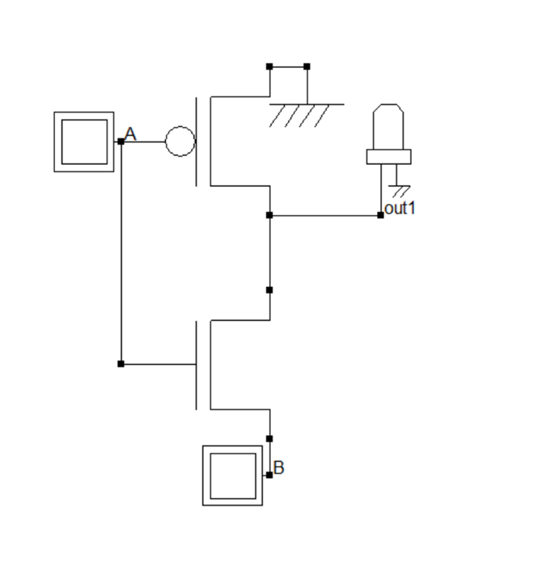
Circuit Diagram:-
It consist of One PMOS where source is connected to GND ,Drain to O/p and Gate to one of input A and One NMOS where source is connected to another input B ,Drain to O/p and Gate to one of input A

Slide 5
OR Gate:-
A | B | Y=A OR B | PMOS | NMOS | Output
0 | 0 | 0 | ON | OFF | B=0
0 | 1 | 1 | ON | OFF | B=1
1 | 0 | 1 | OFF | ON | Vdd
1 | 1 | 1 | OFF | ON | Vdd

Slide 6
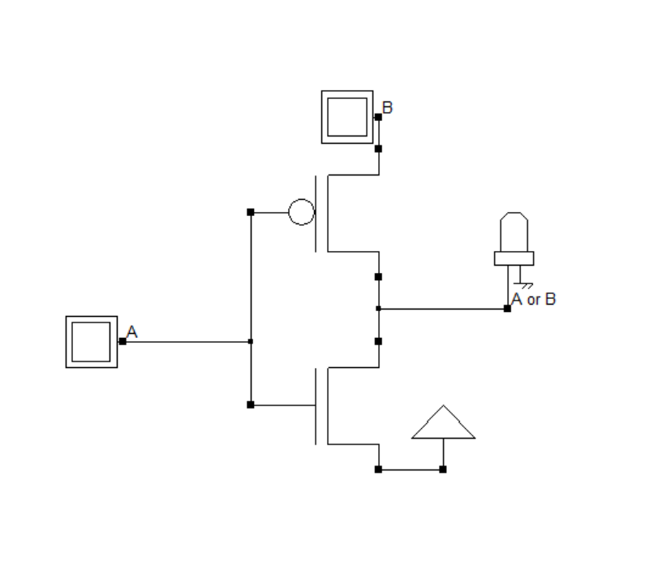
Circuit Diagram:-
It consist of One PMOS where source is connected to another Input B ,Drain to O/p and Gate to input A and One NMOS where source is connected to Vdd ,Drain to O/p and Gate to one of input A

Slide 7
XOR Gate:-
A | B | Y=A XOR B | PMOS | NMOS | Output
0 | 0 | 0 | ON | OFF | B=0
0 | 1 | 1 | ON | OFF | B=1
1 | 0 | 1 | OFF | ON | ~B=1
1 | 1 | 0 | OFF | ON | ~B=0

Slide 8
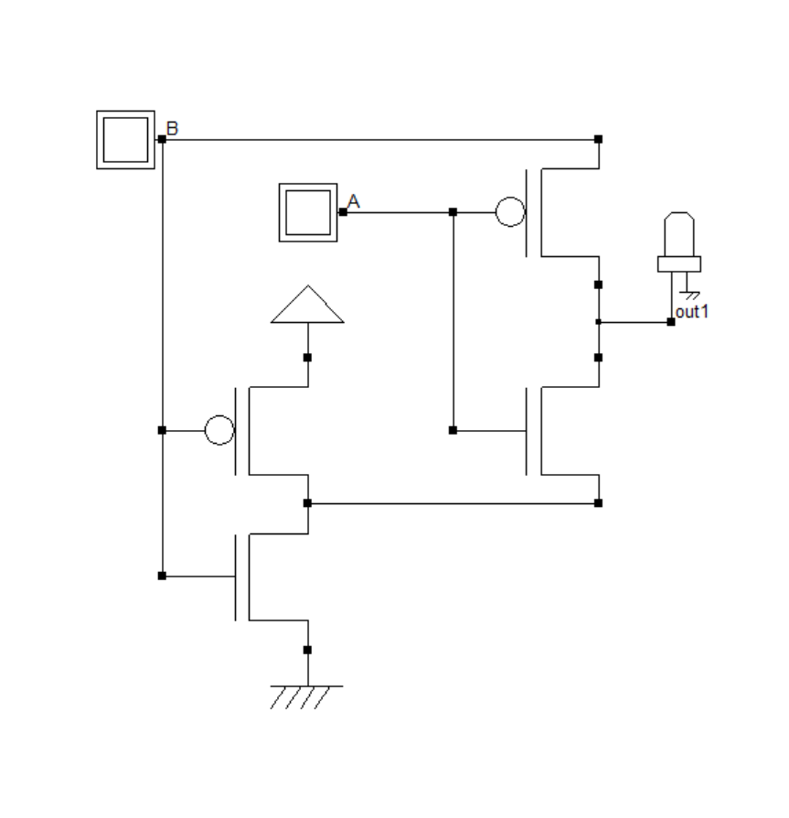
Circuit Diagram:-
It consist of One PMOS where source is connected to another Input B ,Drain to O/p and Gate to one of input A and One NMOS where source is connected to input invert of B ,Drain to O/p and Gate to one of input A

Slide 9
Multiplexer:-
DATA | SELECT | OUTPUT | PMOS | NMOS | OUTPUT
A | 0 | A | ON | OFF | A
B | 1 | B | OFF | ON | B

Slide 10
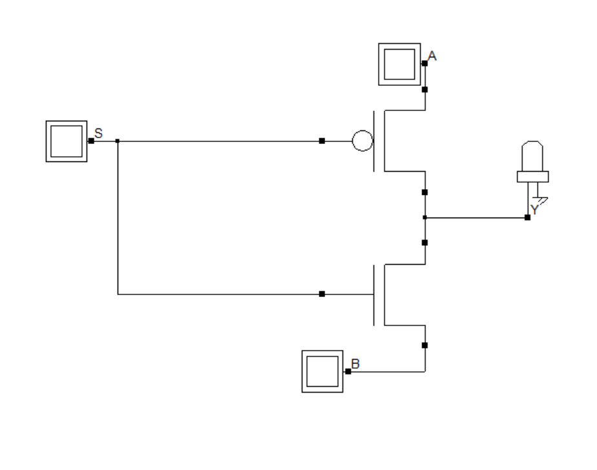
Circuit Diagram:-
It consist of One PMOS where source is connected to another Input B ,Drain to O/p and Gate to one of input A and One NMOS where source is connected to input invert of B ,Drain to O/p and Gate to one of input A

Slide 11
→ Using Basic gate and Mux’s , ALU is designed
→ ALU with two inputs A and B of each four bits ,opcode of 4 bit and A/B switch for single operand operations with output of 4 bit and Cout.
→ALU For RISC Processor consist of mainly four types of operations :-
1.Arithmetic operations
2.Bitwise operations
3.Logical Shift operations
4.Arithmatic Shift operations

Slide 12
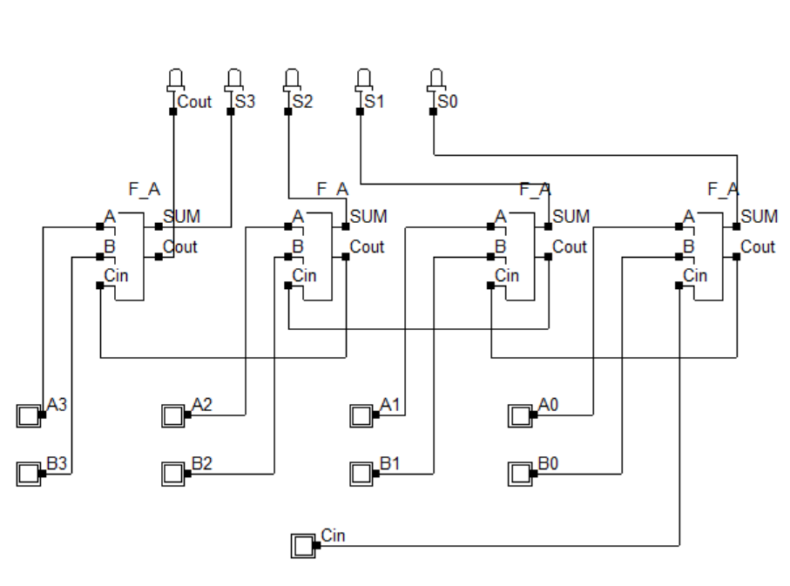
Arithmetic operations:-
→ ADDITION:-

Slide 13
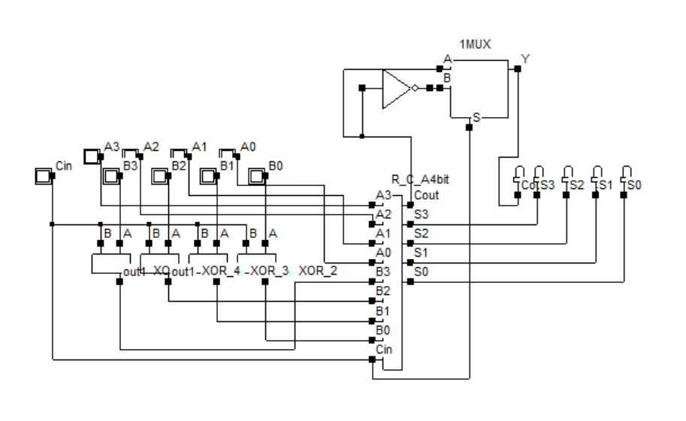
→ Subtraction:-

Slide 14
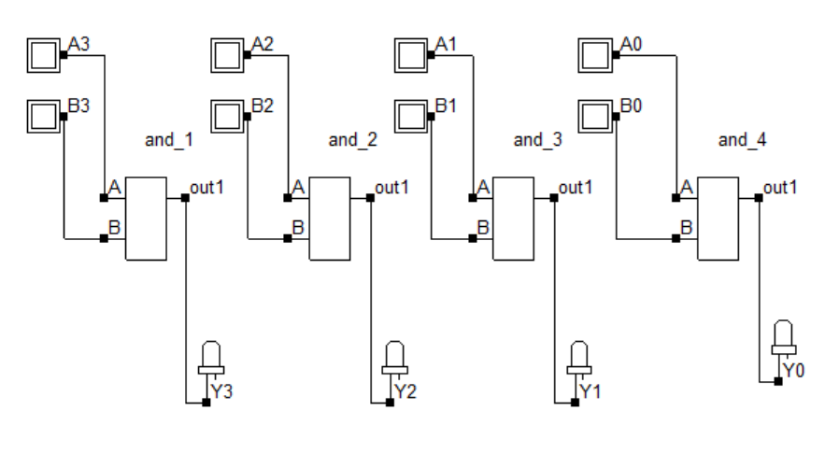
Bitwise operations:-
→ Bitwise AND operation:-

Slide 15
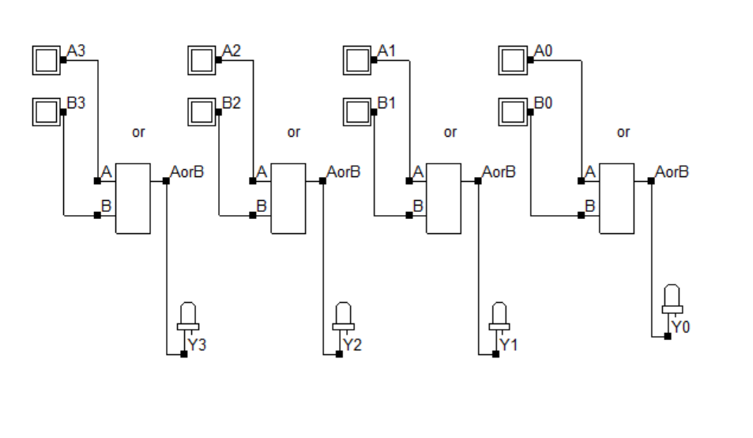
→ Bitwise OR operation:-

Slide 16
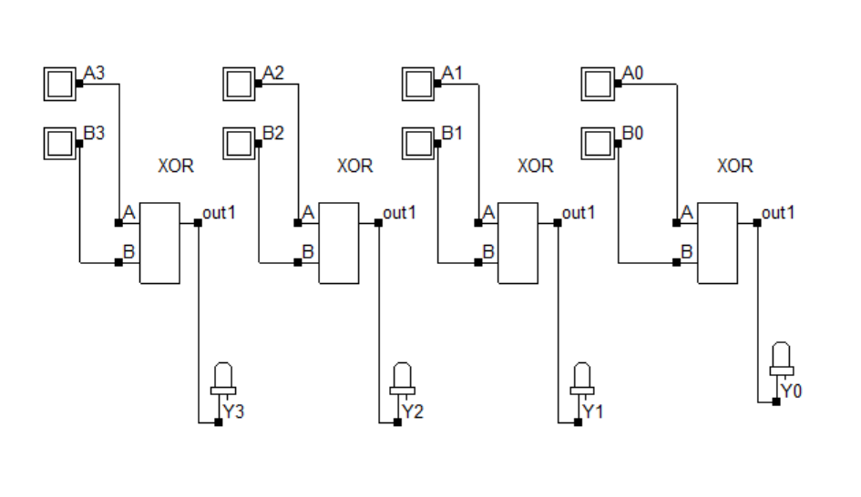
Bitwise XOR operation:-

Slide 17
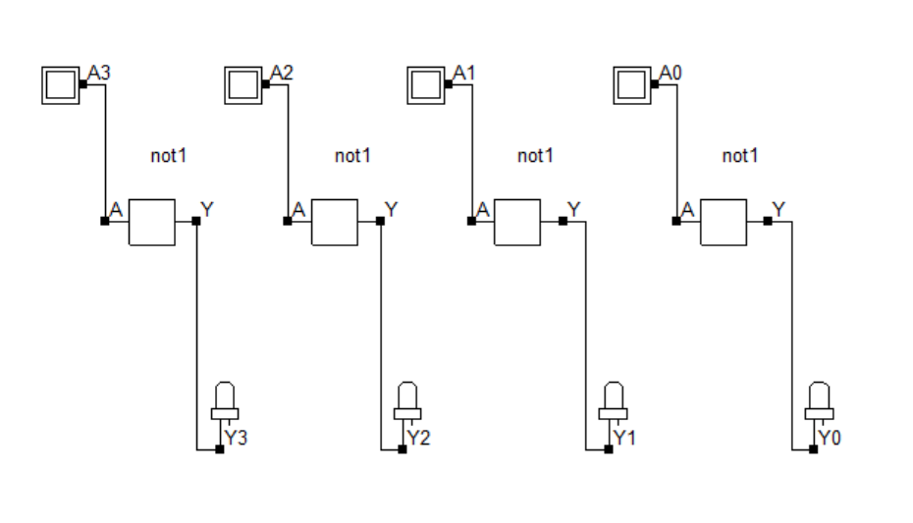
→ Bitwise NOT operation:-

Slide 18
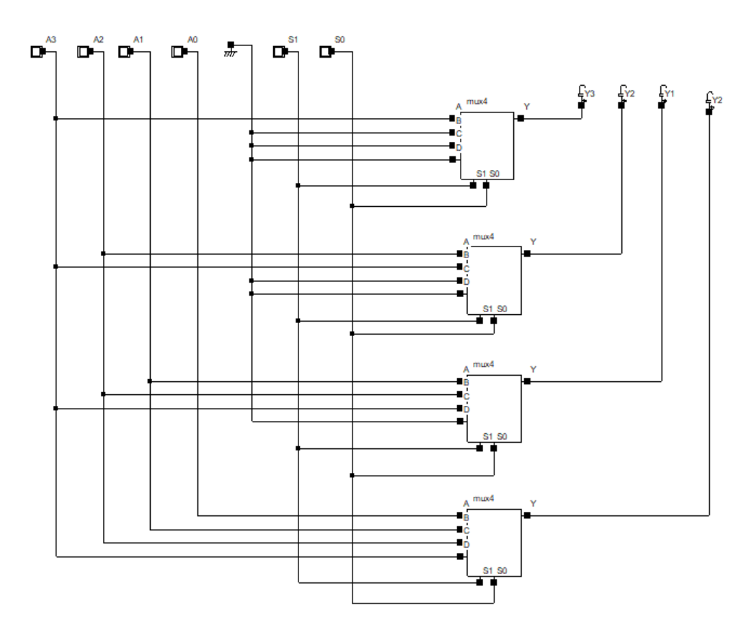
Logical Shift operations:-
→ Right Shift:-

Slide 19
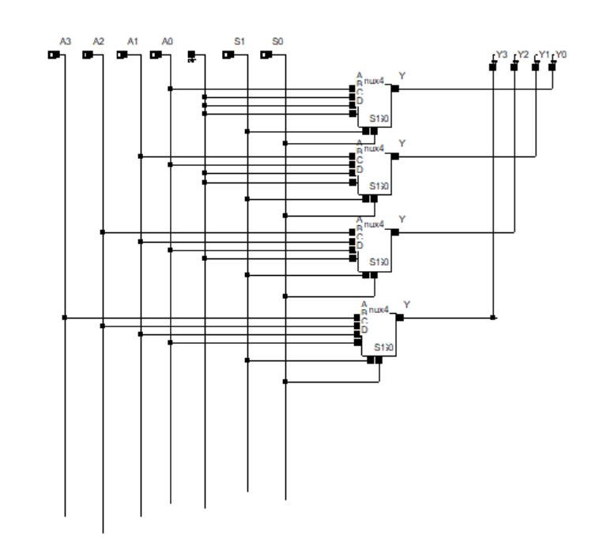
Left Shift:-

Slide 20
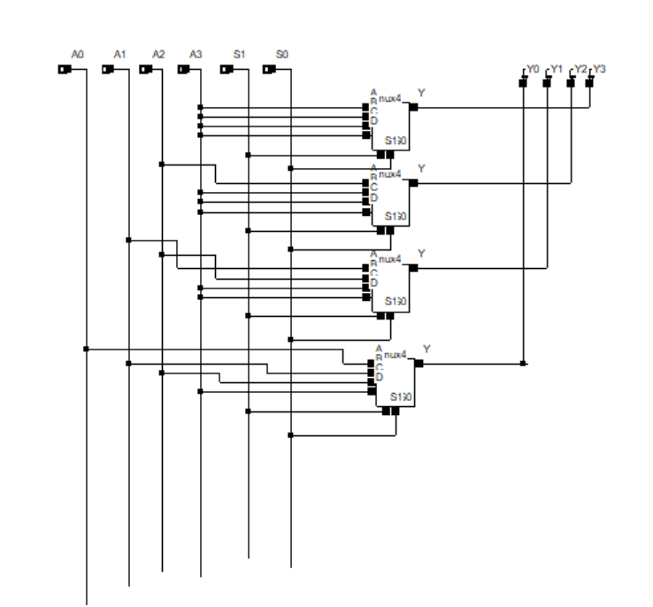
Arithmetic Shift operations:-
→ Right Shift:-

Slide 21
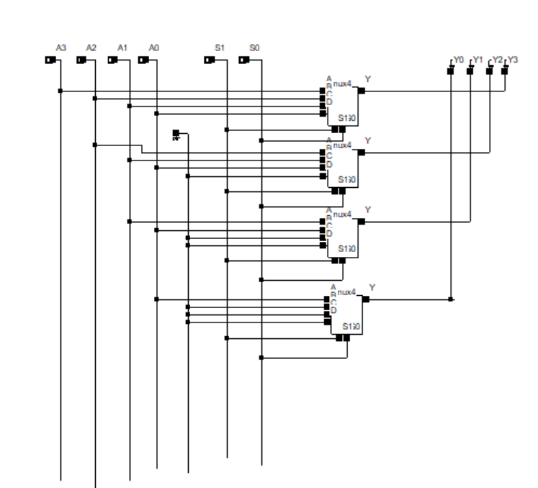
→ Left Shift:-

Slide 22
Double operand:-
Opcode: Operation:
3 Addition
F Subtraction
E Bitwise AND operation
A Bitwise OR Operation
6 Bitwise XOR Operation

Slide 23
Single Operand:-
2 A/B=0 Invert of A
2 A/B=1 Invert of B
1 A/B=0 Logical right shift of A
1 A/B=1 Logical right shift of B
D A/B=0 Logical Left shift of A
D A/B=1 Logical Left shift of B
0 A/B=0 Arithmetic right shift of A
0 A/B=1 Arithmetic right shift of B
C A/B=0 Arithmetic Left shift of A
C A/B=1 Arithmetic Left shift of B

Slide 24
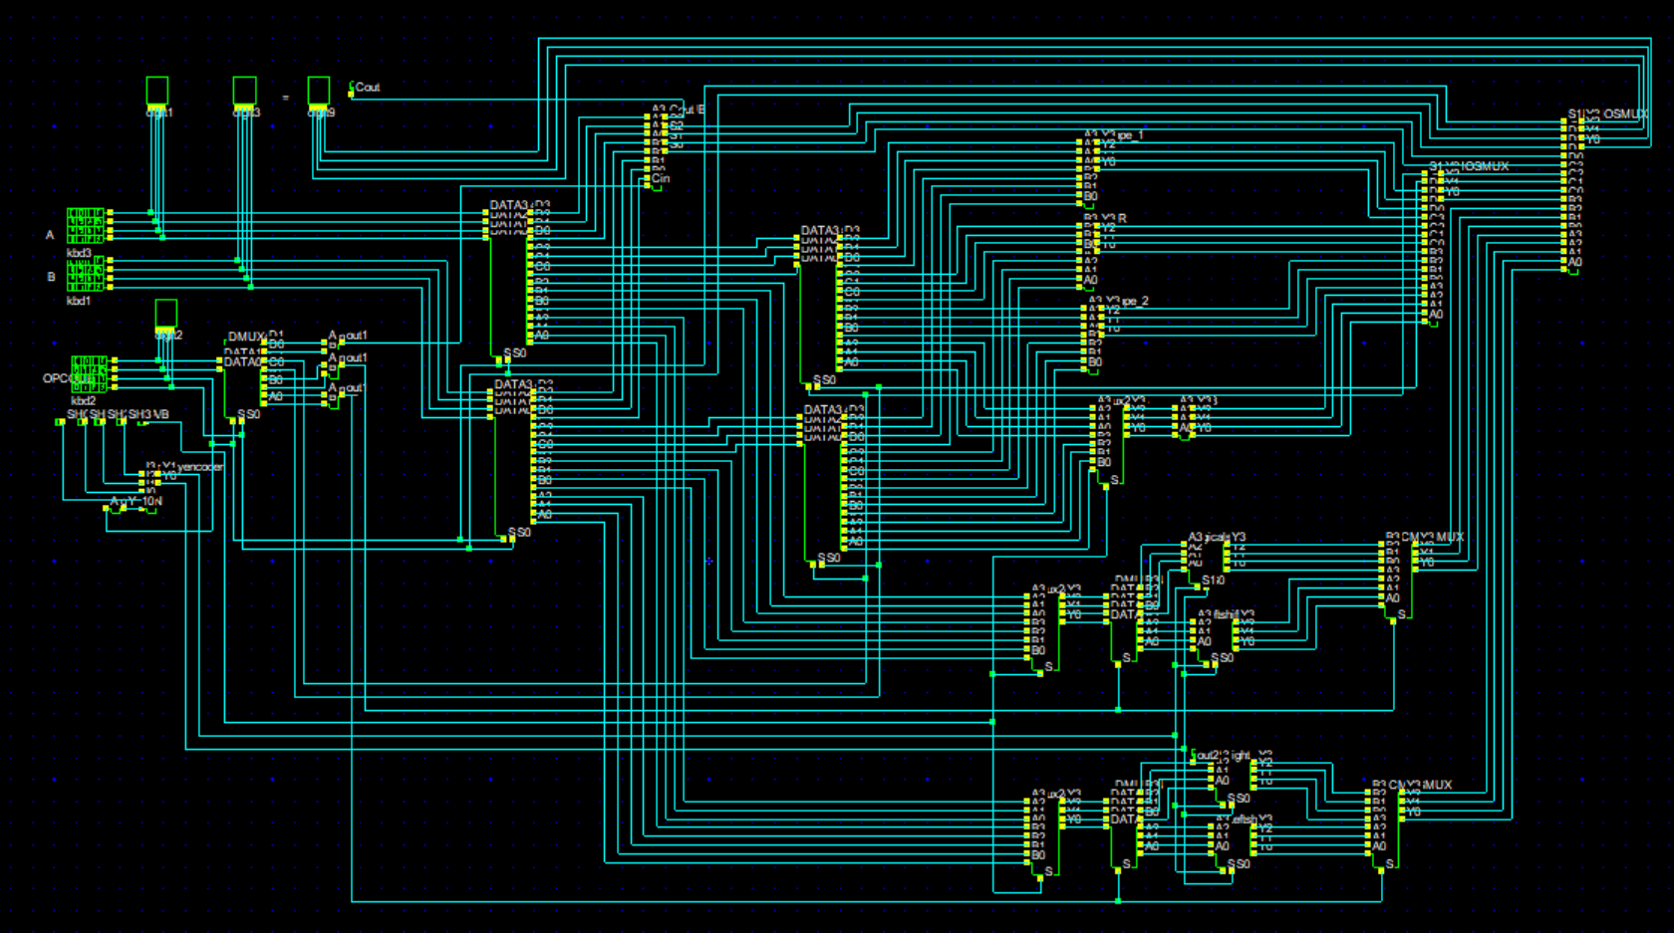
ALU Circuit:-

Slide 25
Conclusion:-
→This ALU can be used for embedded systems which need Low power ALU
→The pass transistor Logic can’t produce strong 0’s /1’s for logic input 10 and 11
→This draw back can be overcome by this modified pass transistor logic
→Power and area consumption can be reduced when compared to existing CMOS Logic Design.

Slide 26
THANK YOU

